Slide 1
Bridging semantics and syntax with graph algorithms —state-of-the-art of extracting biomedical relations
Yuan Luo,O¨ zlem Uzuner and Peter Szolovits
160728

Slide 2
Introduction
Relation extraction from text documents is an important task
in knowledge representation and inference to augment structured knowledge bases
in turn support question answering and decision making.
The task is
annotating unstructured text with named entities
identifying the relations between these annotated entities.
State-of-the-art named entity recognizers can automatically annotate text with high accuracy, but relation extraction is not as straightforward.
General domain relation extraction is an active research area for decades.
Extracting relations from scientific publications in the biomedical and clinical domain and clinical is the focus of this review.

Slide 3
Introduction
Immunophenotypic features are expressed as relations among medical concepts.
ex) ‘[large atypical cells] are
positive for [CD30]
negative for [CD15]’
‘large atypical cells’, ‘CD30’ and ‘CD15’ are medical concepts.
A bag-of-words or bag-of-concepts representation would fail to capture whether ‘large atypical cells’ are positive or negative for ‘CD30’ or ‘CD15’
In this and many other similar cases, the biomedical concepts need to be linked through syntax and/or semantics to be informative and to resolve ambiguities by putting the concepts into context.

Slide 4
Introduction
In this article, we define a relation as a tuple r(c1,c2, . . ., cn), n2, where ci’s are concepts (named entities) and the ci’s are semantically and/or syntactically linked to form relation r, as expressed in text.
Thus, a single named entity is generally not regarded as a relation, neither is an assertion.
If n is two (three), we call the relation a binary (ternary) relation, and for general n an nary relation.
For example
positive-expression(large atypical cells, CD30)
negative-expression(large atypical cells, CD15)
[positive-expression(large atypical cells, CD30), negative-expression(large atypical cells, CD15)] as ‘nested event’.

Slide 5
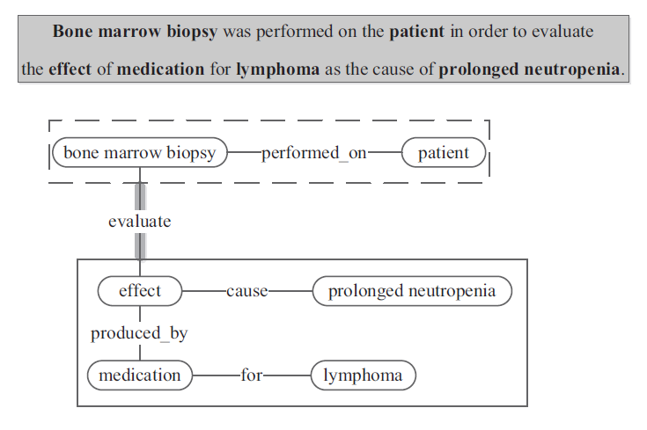
Introduction
We also use the term relation to include what are often referred to as events.
treated_by (patient, Imatinib regimen, 5 months)
‘[the patient] was put on [Imatinib regimen] for [5 months]’
The event trigger is ‘put’
The theme is ‘Imatinib regimen’
The target argument is ‘patient’
Nested events may occur when one event takes other events as arguments;
In computational linguistics, events are often defined as grammatical objects that combine lexical elements, logical semantics, and syntax.

Slide 6
Introduction
The Dashed box denotes a binary relation
The Solid box is a collection of three binary relations.
Dashed box and Solid box can be interpreted as a nested event.
The natural language processing (NLP) techniques for extracting relations and events are often similar in principle.
Thus, we include both relation and event extraction in our review, and we use both ‘relation’ and ‘event’, with the choice made to be consistent with the literature being referenced.

Slide 7
Introduction
The representation of relations has been a subject of knowledge representation research for decades with various alternatives.
One representation uses composed simple logical forms.
Resource Description Framework (RDF) or Web Ontology Language(OWL)
<subject-predicate-object triple representation>
large atypical cells-positively express-CD30.
The sentential logic (or propositional logic) representation, in which relations are propositions or composed propositions using logical connectives
(e.g. ‘and’ for conjunction, ‘or’ for disjunction).
Compared with RDF triples, propositional logic has additional constructs such as connectives and inference rules, thus is more expressive.
The graph-based representation in which nodes are named entities and edges indicate relationships, or multiple named entities connected by multiple edges can be regarded as one relation, as shown in Figure 1.
This review focuses on NLP methods using graph-based representations and algorithms to extract biomedical relations from unstructured text.

Slide 8
Introduction
Regarding alternative representations, the sentential logic representation can be noted with graph based representation.
Biomedical concepts to nodes and syntactic/semantic links to edges.
Other propositional representations may require specific interpretation of the graphs.
representing the negation of a proposition may require the introduction of nested graphs, and to give special semantics to a relation labeled NOT.
We can focus on common syntactic and semantic graphical patterns that provide good ways to capture relations.
This review use curated structured knowledge bases.
biologically focused : KEGG, STRING, InterPro and InterDom.
clinically focused : PharmGKB , VARIMED and ClinVar.

Slide 9
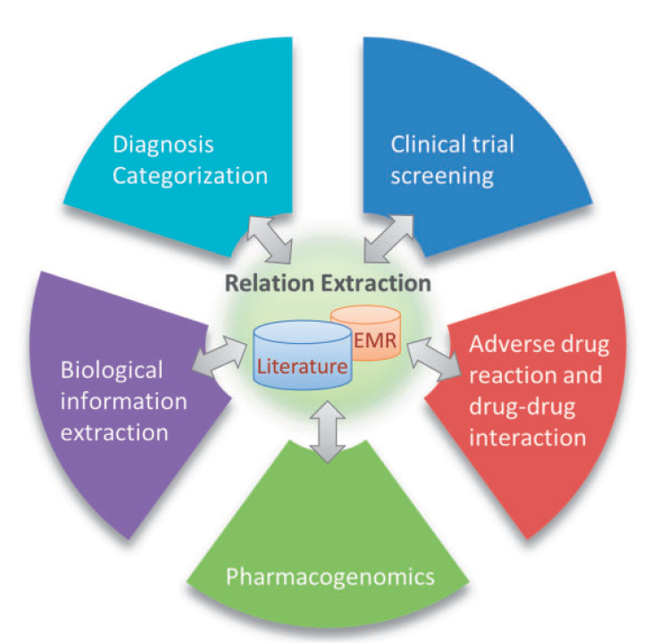
Application of biomedical relation extraction
Extracting biomedical relations has numerous applications that vary from advancing basic sciences to improving clinical practices.
biomolecular information extraction
clinical trial screening
pharmacogenomics
diagnosis categorization
adverse drug reactions (ADRs)
drug–drug interactions (DDIs).

Slide 10
Application of biomedical relation extraction - Biomolecular information extraction
To keep up with the exponential growth of the literature, automated methods have been applied to mining
protein–protein interactions (PPIs)
gene–phenotype associations
gene ontology
pathway information, which we collectively call biomolecular information extraction.
Such relation mining has shown its value in the prioritization of cancerous genes for further validation from a large number of candidates.
Many of these approaches apply NLP methods to extract known disease–gene relations from the literature, which are then used to predict novel disease–gene relations.

Slide 11
Application of biomedical relation extraction - Clinical trial screening
Archived clinical and research data have been made available by governmental agencies and corporations,
such as ClinicalTrials.gov.
Clinical trials are in large part characterized by eligibility criteria, some of which can be captured via relations
(e.g. no [diagnosis] for [rheumatoid arthritis] for at least [6 months]).
Electronic screening can improve efficiency in clinical trial recruitment, and intelligent query over trials can support clinical knowledge curation.
Recently, NLP support has proved useful
in automatically detecting named entities in eligibility criteria
in extracting relations between named entities to characterize eligibility criteria.

Slide 12
Application of biomedical relation extraction - Pharmacogenomics
Pharmacogenomics aims to understand how different patients respond to drugs by studying relations between drug response phenotypes and patient genetic variations.
Much of this knowledge can be mined from scientific literature and curated in databases to enable discovering new relationships.
One such database is the Pharmacogenetics Research Network and Knowledge Base (PharmGKB).
Initial efforts to populate PharmGKB included a mixture of expert annotation and rulebased approaches.
Recent approaches have extended to using
semantic and syntactic analysis
statistical machine learning tools to mine targeted pharmacogenomics relations from scientific literature and clinical records

Slide 13
Application of biomedical relation extraction - Diagnosis categorization
Diagnosis categorization enables automated billing and patient cohort selection for secondary research.
Developed systems can automatically code and classify diagnoses from Electronic Medical Records (EMRs).
Recent work demonstrated
the success of extracting semantic relations
using these relations as additional features in diagnosis categorization
using through better grouping features using curated relations
using through unsupervised learning to extract more expressive representation of relations between medical concepts.

Slide 14
Application of biomedical relation extraction - ADR and DDI
ADR refers to unexpected injuries caused by taking a medication.
ADR is an important cause of morbidity and mortality
DDI happens when a drug affects the activity of another drug simultaneously administered.
DDIs may cause reduced drug efficacy or drug overdose.
Detecting potential ADRs and DDIs can guide the process of drug development.
An increasing number of methods have leveraged the scientific literature and clinical records using NLP.
These systems often explore the relations between drugs, genes and pathways, and discover ADRs and DDIs stated in text.
A large amount of research in recent years also explored user-generated content in social networks to detect ADRs.

Slide 15
General pipeline for biomedical relation extraction
The pipeline covers steps for
breaking the documents to sentences,
understanding the semantic and syntactic structures of sentences
constructing a multitude of features for relation extraction.
The pipeline can also be used as a foundation for downstream applications such as logical inference with extracted relations.
We emphasize the role of graph mining in the pipeline as a central concept.
The mined graphs provide a converging point for methods that combine local features
(e.g. tokens and part-of-speech tags)
a diverging point where more integrated features(e.g. relations as features) are constructed, a bridge to connect the syntax and semantics.

Slide 16
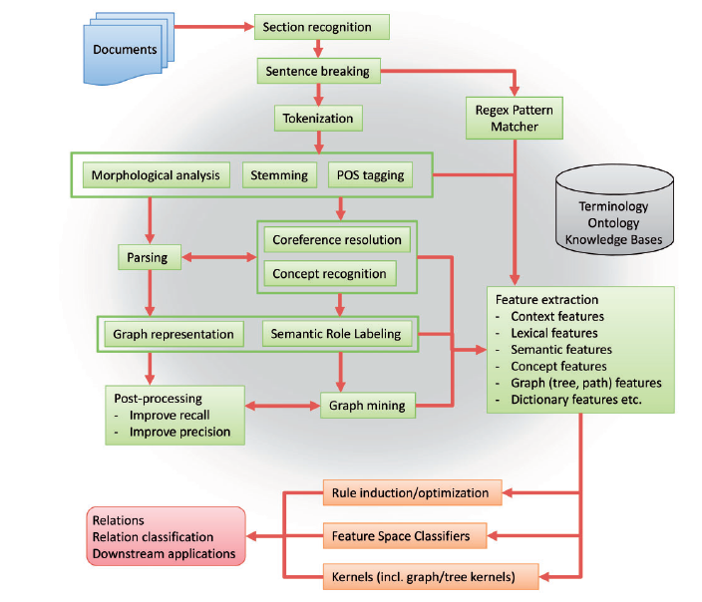
General pipeline for biomedical relation extraction

Slide 17
General pipeline for biomedical relation extraction
we assume documents as input and extracted relations as output.
The pipeline starts with section recognition, which distinguishes text under different section headings
(e.g. ‘Chief Complaints’ or ‘Past Medical History’).
Sentence breaking automatically decides where sentences in a paragraph begin and end.
Typographical analysis investigates features such as capitalization and usage of alphanumeric characters.
Stemming reduces the inflected words to the root form (e.g. performed to perform).
POS tagging assigns a part-of-speech tag for each word in the sentence
(e.g. VBN for ‘performed’ in the sentence in Figure 1).
Parsing is the process of assigning a syntactic structure to a sentence
(e.g. the constituency or dependency structure obtained by Stanford Parser).
The results from typographical analysis, stemming, POS tagging and parsing can provide features for recognizing anaphora (coreference resolution) and typed concepts (concept recognition).
Coreference resolution and concept resolution can also improve parsing accuracy.
Together with parsing, they are essential in generating the graph representation for a sentence and labeling semantic roles of concepts in the graph representation (Semantic Role Labeling).
The graph representation is the foundation for graph mining, and along with upstream steps including direct regular expression feature extraction, leads to the generation of semantically and syntactically enriched features.
Many biomedical relation extraction systems rely on external knowledge sources [e.g. Unified Medical Language System (UMLS)

